Slide 1


App Inventor Healthy Plants CIS Summer Camp
Kevin Ng
Notes:
Use google chrome!! Cantonese!

Slide 2




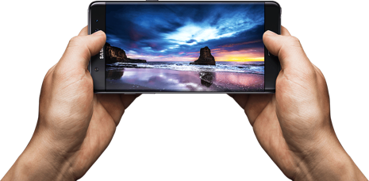
Notes:
Will animate in powerpoint so icons move and grow out of the phone

Slide 3
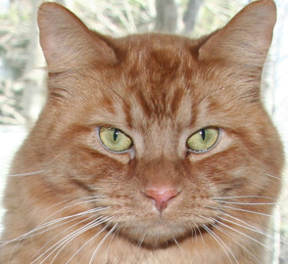
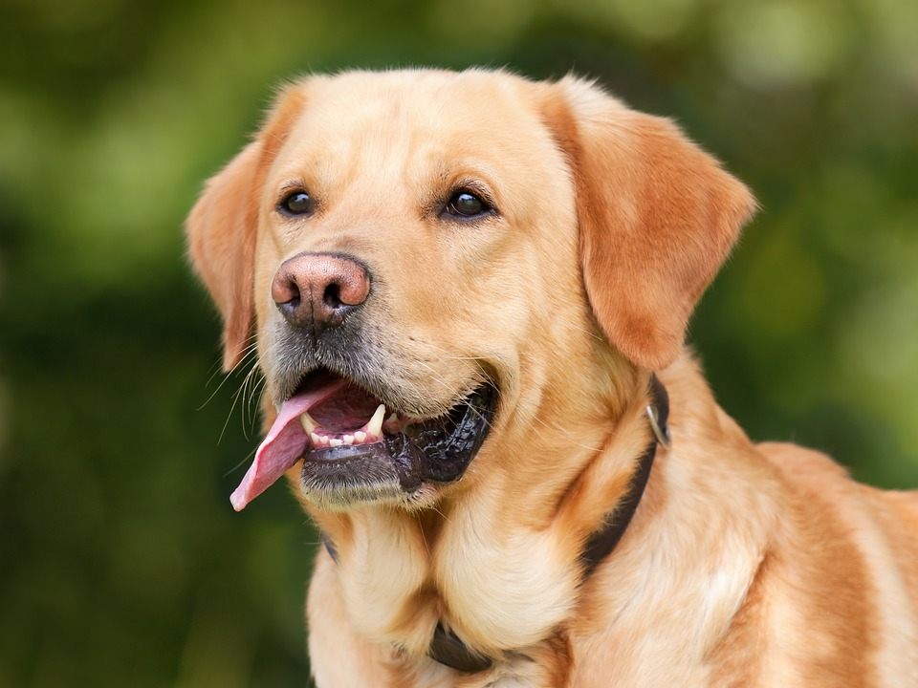
HelloWoofPurr
Notes:
Hello Purr Interlude - use handouts

Slide 4
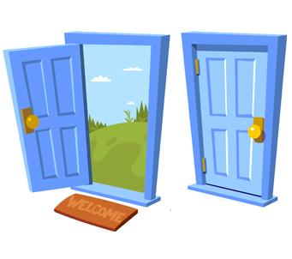




Notes:
Probably include some video here to show IoT

Slide 5
Healthy Plants
Notes:
Healthy Plants hand out.

Slide 7
A2 : Moisture Sensor
D4: Temperature Sensor
I2C: LCD Screen
A1: Light Sensor

Slide 8
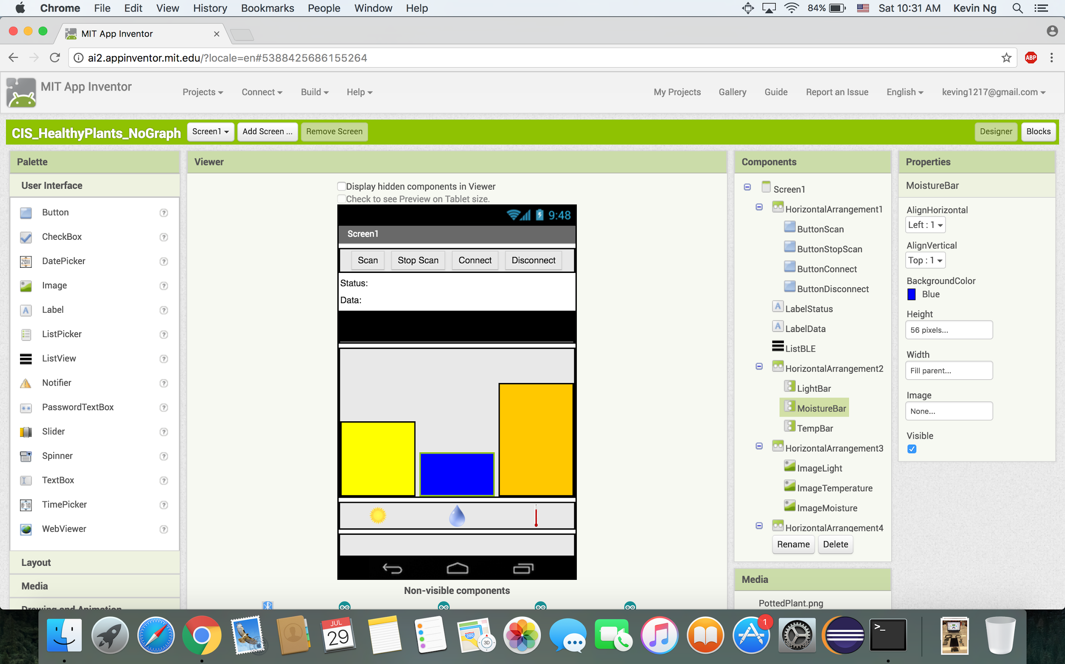

Slide 9
